Slide 1
Searching the Web

Slide 2
Outline
Introduction
Characterizing the Web
Three different forms
  Search engines
    AltaVista
  Web directories
    Yahoo
  Hyperlink search
    WebGlimpse

Slide 3
Introduction
Introduction
  The WWW dates from the end of the 1980s
  Can be seen as a very large, unstructured but ubiquitous database
  Need for efficient tools to manage, retrieve and filter information from this database

Slide 4
Challenges on the Web
Distributed data
Volatile data
Large volume
Unstructured and redundant data
Data quality
Heterogeneous data

Slide 5
Measuring the Web
The size of the Web (the number of hosts)
  Netsizer, http://www.netsizer.com
    2.7 million web servers, 65 million internet hosts, 1999
  Netcraft, http://www.netcraft.com/Survey/
    8 million web servers using different web servers, 1999
  Internet Domain Survey, http://www.nw.com
    56 million internet hosts
  WWW Consortium (W3C)

Slide 6
Other measures
The number of different institutions maintain Web
  more than 40% of the number of Web servers
The number of Web pages
  350 million in Jul. 1998 [BB98, WWW7]
    20,000 random queries based on a lexicon of 400,000 words extracted from Yahoo
    the union of all answers from four search engines covered about 70% of the Web
The size of a page
  5Kb on average with a median 2Kbs

Slide 7
Other measures (cont.)
The number of links in a page
  5~15 links, 8 on average
  80% of these home pages had fewer than 10 external links
Yahoo and other web directories are the glue of the Web
The size of Web size (in bytes)
  5Kb*350 million=1.7 terabytes
The languages of the Web

Slide 8
Modeling the Web
Heaps’ and Zipf’s laws are also valid in the Web
  In particular, the vocabulary grows faster (larger β) and the word distribution should be more biased (larger θ)
Heaps’ Law
  An empirical rule which describes the vocabulary growth as a function of the text size.
Zipf’s Law
  An empirical rule that describes the frequency of the text words.

Slide 9
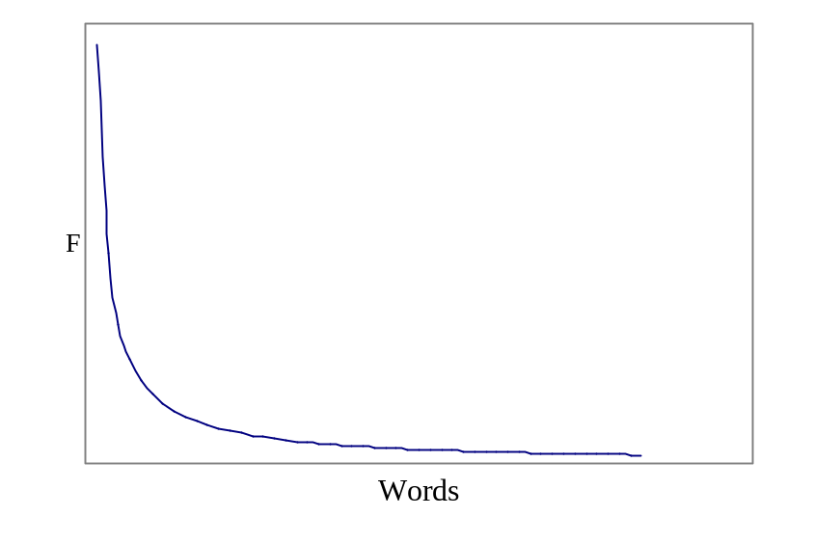
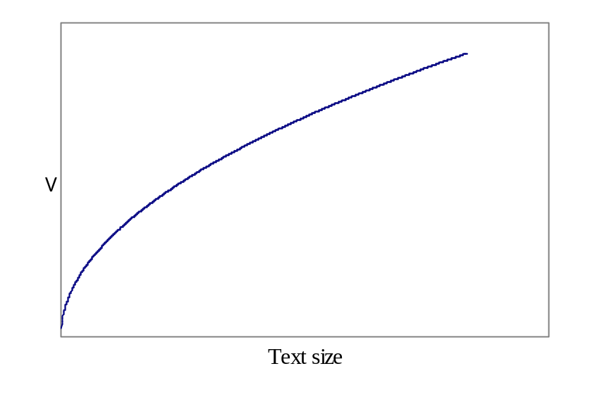
Zipf’s and Heaps’ Law
Distribution of sorted word frequencies (left) and size of the vocabulary (right)

Slide 10
Search Engines
Centralized Architecture
Distributed Architecture
User Interface
Ranking
Crawling the Web
Indices

Slide 11
Typical Crawler-Indexer Architecture
Query Engine
(Ranking)
Index
Interface
Indexer
Crawler

Slide 12
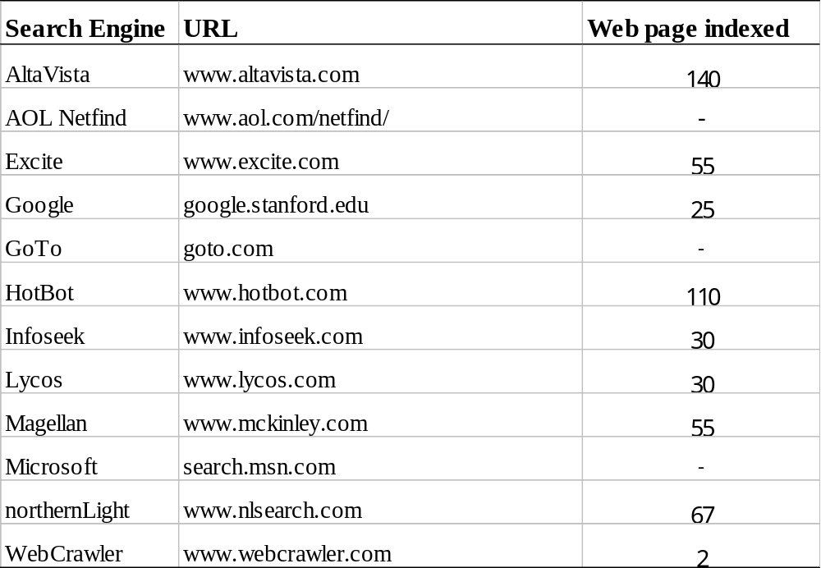
Centralized Architecture

Slide 13
Centralized Architecture
HotBot, GoTo and Microsoft are powered by Inktomi
Magellan are powered by Excite’s internal engine
Others
  DirectHit, http://www.directhit.com
    ranks the Web pages in the order of their popularity

Slide 14
Distributed Architecture
Harvest
  Gatherers: collect and extract indexing information from one or more Web servers
  Brokers: provide the indexing mechanism and the query interface to the data gathered
Replication manager
Broker
User
Broker
Gatherer
Object Cache
Web

Slide 15
User Interface
Query interface
  AltaVista: OR
  HotBot: AND
Answer interface
  order by relevance
  order by Url or date
  option: find documents similar to each Web page

Slide 16
Ranking
Most search engines follow traditional
  Boolean or Vector Model
  Yuwono and Lee (1996)
    Boolean spread
    vector spread
    Most-cited
Hyperlink Information
  WebQuery – allows visual browsing of web pages
  Li98, Internet Computing
  HITS (Hypertext Induced Topic Search)
  PageRank, Google

Slide 17
Crawling the Web
Synonyms
  spider, robot, crawler, etc.
  Starting from a set of popular URLs
  Partition the Web using country codes or Internet names
Crawling order
  Depth-first, breadth-first
robot.txt
  Guidelines for robot behavior includes what pages should not be indexed
  e.g. dynamically generated pages, password protected pages

Slide 18
Indices
Variants of Inverted file
  A short description of each Web page is complemented
    creation data, size, the title and the first lines or a few headings
    500 bytes for each page*100 million pages = 50 GB
  30% of the text size
    5 KB for each page*100 million pages*30% = 150 GB
  compression
    50GB
Binary Search on the sorted list of words of the inverted file

Slide 19
Indexing Granularity
Pointing to pages or to word positions is an indication of the granularity of the index
  Use logical blocks instead of pages
    reduce the size of the pointers (fewer blocks than documents)
  Occurrences of a non-frequent word will be clustered in the same block
    reduce the number of pointers
Queries are resolved as for inverted files
  Obtaining a list of blocks that are then searched sequentially
  Exact sequential search: 30Mb/sec
  Glimpse in Harvest

Slide 20
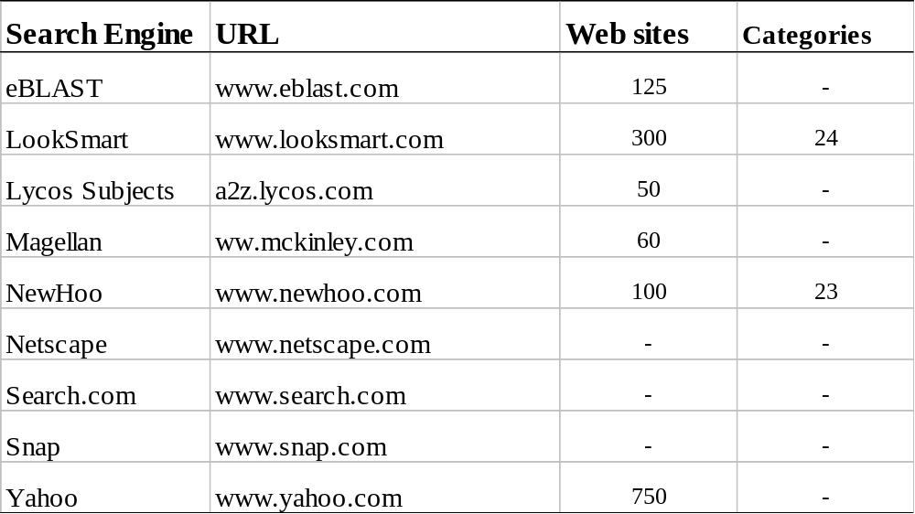
Browsing in Web Directories
Web Directories – one of the Web tool for browsing and searching
Web Directories are also called as catalogs, yellow pages or subject directories

Slide 21
Combining Searching with Browsing
WebGlimpse
  attaches a small search box to the bottom of every HTML page
  allows the search to cover the neighborhood of that page or the whole site without having to stop browsing
  The neighborhood of a Web page is defined as the set of Web pages that are reachable by a path of hypertext links within a maximum predefined distance

Slide 22
Helpful Tools
Many s/w tools to help browsing and searching
Add-ons to browsers, such as Alexa – it provides useful information about the sites like visited, freshness, speed of access etc
WebTaxi
There are other tools that use visual metaphors, which can be classified into two types: tools to visualize a subset of the Web and tools to visualize large answers.

Slide 23
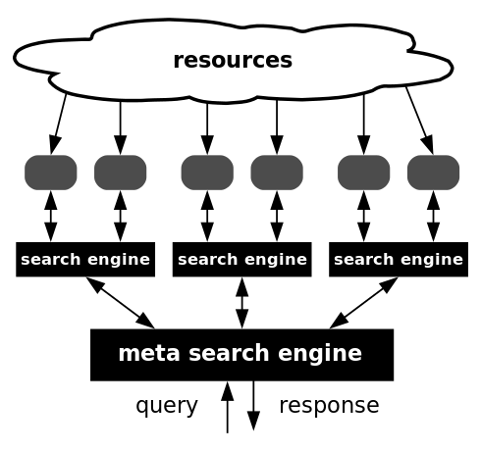
Metasearches
A metasearch engine (or aggregator) is a search tool that uses another search engine's data to produce their own results from the Internet. Metasearch engines take input from a user and simultaneously send out queries to third party search engines for results. Sufficient data is gathered, formatted by their ranks and presented to the users.

Slide 24
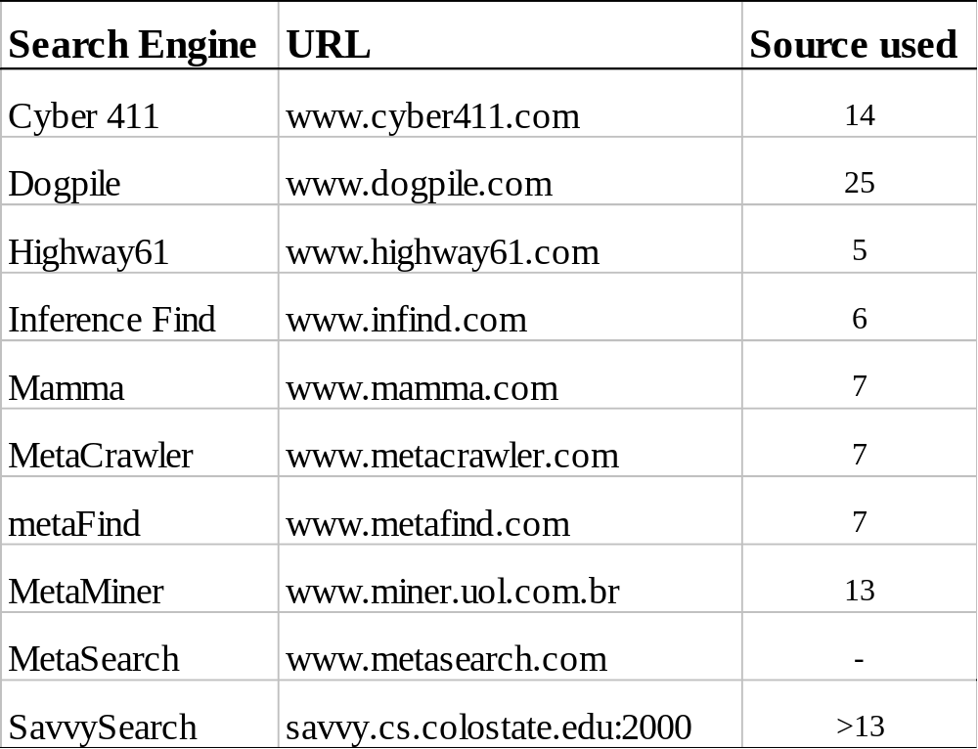

Slide 25
Metasearchers (cont.)
Client side metasearchers
  WebCompass
  WebSeeker
  EchoSearch
  WebFerret
Better ranking
  Inquirus
    NEC Research Institue metasearch engine

Slide 26
Finding the Needle in the Haystack
User Problems
  User does not exactly understand the meaning of searching using a set of words
  User is not aware of the logical view of the text adopted by the system
Some Examples
Teaching the user

Slide 27
Searching using Hyperlinks
[1] Web Query Languages
  Queries can also include the link structure connecting web pages
Different data models has to be used here
  Ex: labeled graph model
Web Query Languages have been extended
  Extracting and integrating information from web pages and constructing and restructuring websites

Slide 28
[2] Dynamic Search and Software Agents
The idea is to use an online search to discover relevant information by following links
Fish search
Shark search
Searching specific information
  LaMacchia
  SiteHelper
Shopping robots
  Jango
  Junglee
  Express

